Slide 1
Marketing Website Analytics
Submitted by:
Pranav Sathe

Slide 2
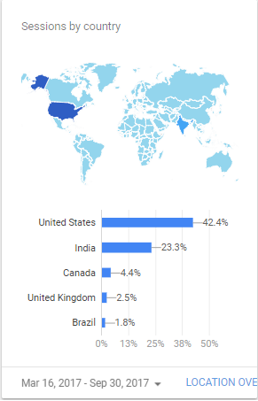
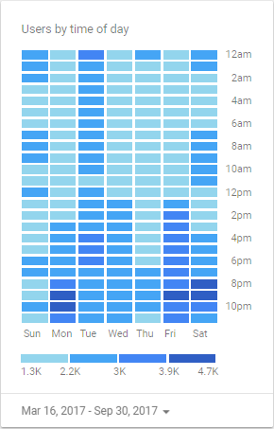
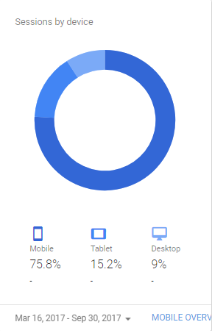
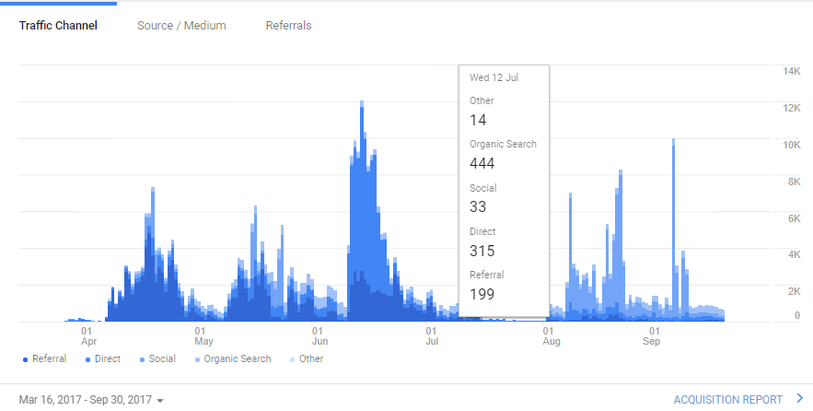
Data Background – Backdrop of the company
How do we acquire users?
Digital Media is numerical, networked and interactive system of links and databases that allows us to navigate from one bit of content or web page to another.

Slide 3
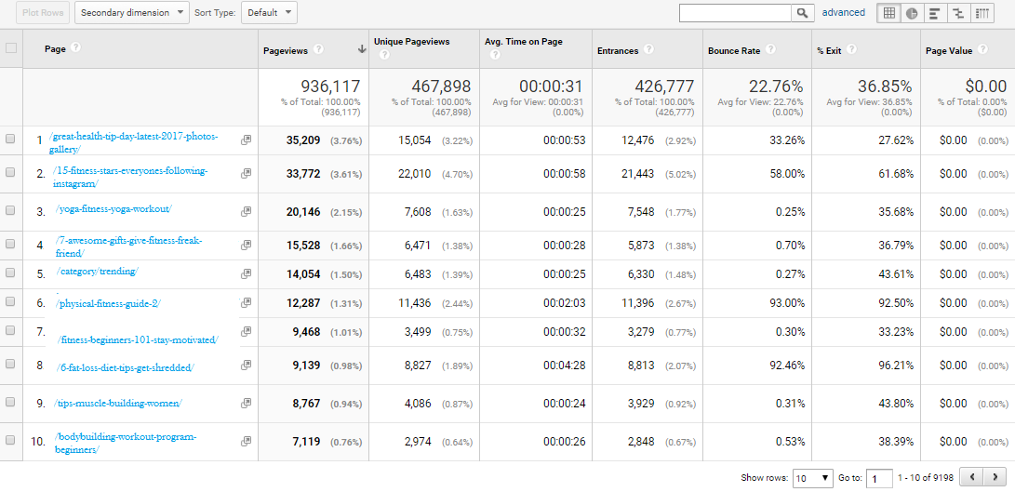
Data Background – Behavior Overview

Slide 4
Classification Model
Page URL
Unique Page Views
Avg Time on Page
System
Page Views
Bounce Rate
Entrances
% Exit

Slide 5
Data Background – Dataset and Attributes
Attribute Name | Descriptions
Page URL | The pages visited, listed by URI. The URI is the portion of a page's URL following the domain name; for example, the URI portion of www.example.com/contact.html is /contact.html.
Page views | Pageviews is the total number of pages viewed. Repeated views of a single page are counted.
Unique Page Views | Unique Pageviews is the number of sessions during which the specified page was viewed at least once. A unique pageview is counted for each page URL + page Title combination.
Avg. Time on Page | The average amount of time users spent viewing a specified page or screen, or set of pages or screens.
Entrances | Entrances is the number of times visitors entered your site through a specified page or set of pages.
Bounce Rate | The percentage of single-page sessions in which there was no interaction with the page. A bounced session has a duration of 0 seconds.
Exit % | %Exit is (number of exits) / (number of pageviews) for the page or set of pages. It indicates how often users exit from that page or set of pages when they view the page(s).
1st Day | The total number of pageviews for each URL over the initial period of 24 hours over 1st day.
10th Day | The total number of pageviews for each URL over the final period of 24 hours over 1oth day.
(1-10 days) total | Sum of the total number of pageviews for each URL over the initial period of 10 days, day 1 till the 10th day.
(11-20 days)total | Sum of the total number of pageviews for each URL over the period of next 10 days from 11th till the 20th day.
(1-10days)% change | Percentage change of page views over the initial period of 10 days, day 1 till the 10th day.
(11-20 days)% change | Percentage change of page views over the period of next 10 days from 11th till the 20th day.
Notes:
Using the above assumptions and the data set provided by the company following were the input and output variables determined for the current system .
Explain the derived attributes

Slide 6
Data Background – Class attribute
Main objective is to find out the attributes directly responsible for the Page views.
Pageviews reflect the interest level of users and help to design strategies for converting the visitors to potential customers .
Thus, our class attribute is the Percentage Change of Page Views in 11-20 Days.

Slide 7

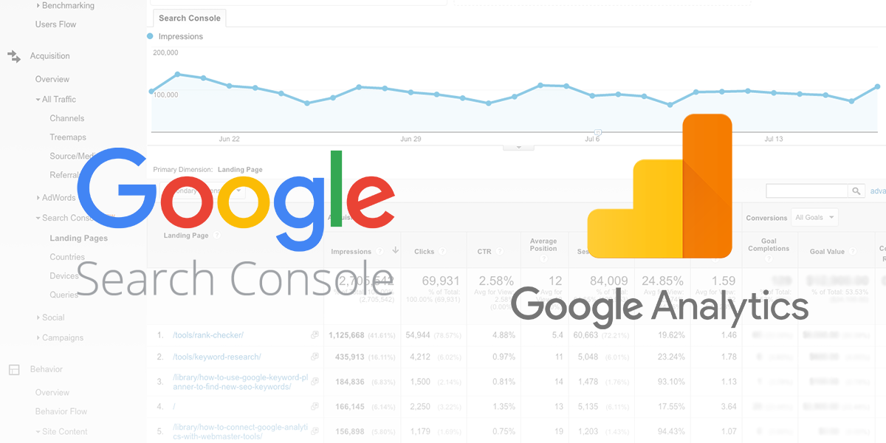

Data cleaning process: Tools used
We used four tools:
Google Analytics
Python
Microsoft Excel
Weka

Slide 8
Data cleaning process
Irrelevant attributes, Missing values, derived attributes
1.Dealing with errors:
Replaced #DIV/0!with 0.
2. Irrelevant Values:
3. Page Value*: Removed attribute
The average value of this page or set of pages. Page Value is ((Transaction Revenue + Total Goal Value) divided by Unique Pageviews for the page or set of pages))
Removed “”, ‘’.

Slide 9
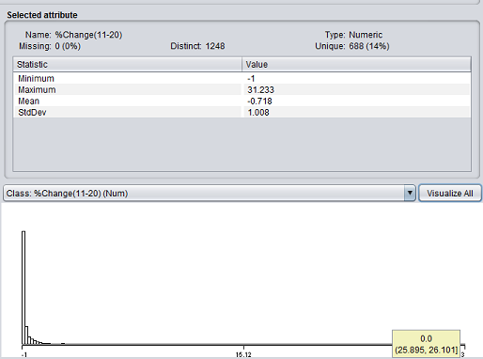
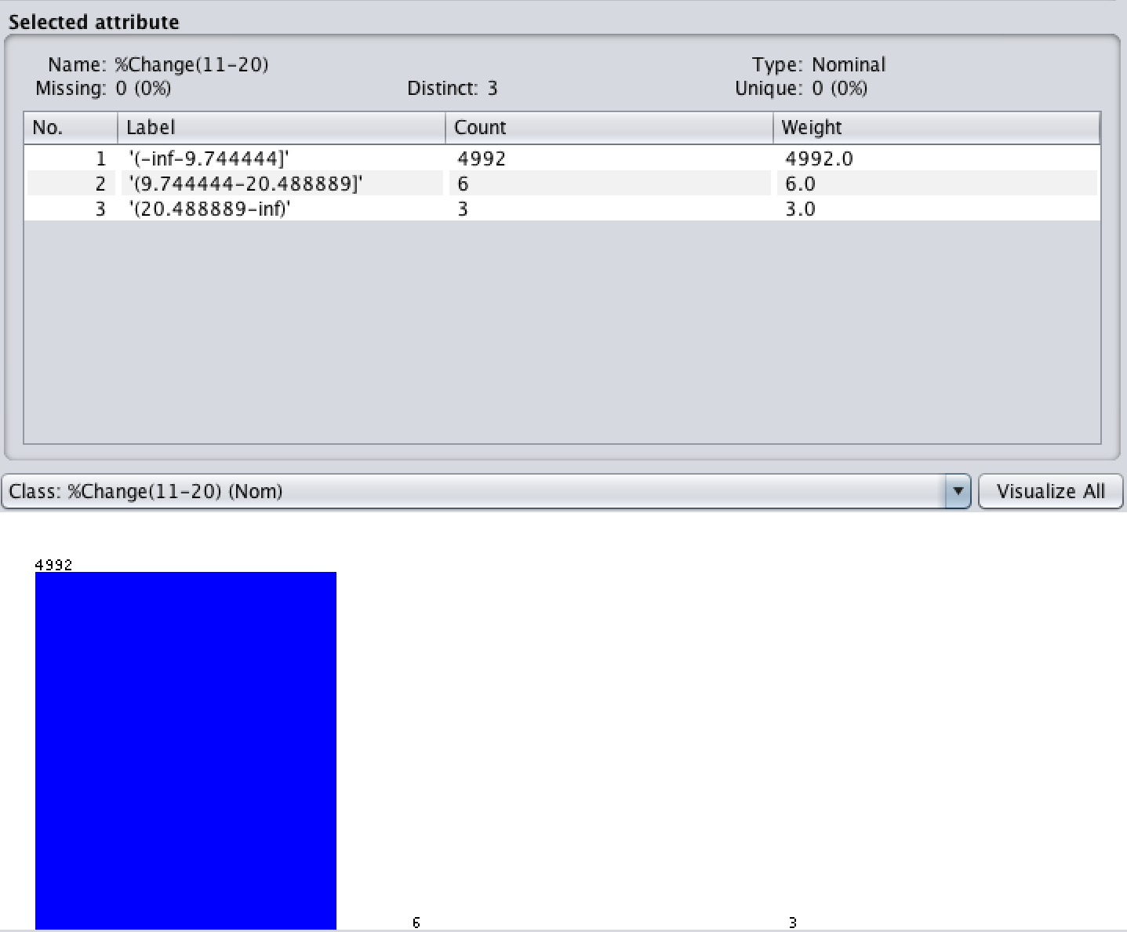
Discretization
Before Discretization After Discretization

Slide 10
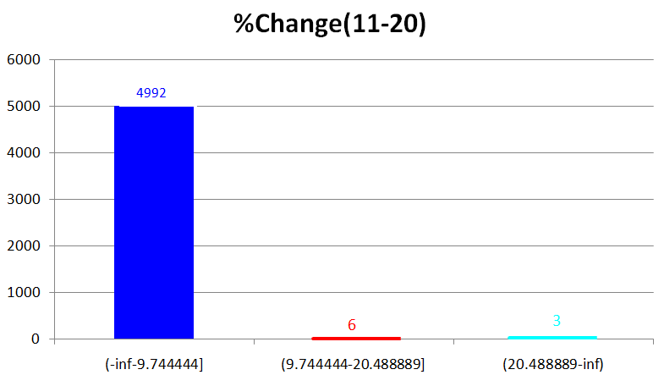
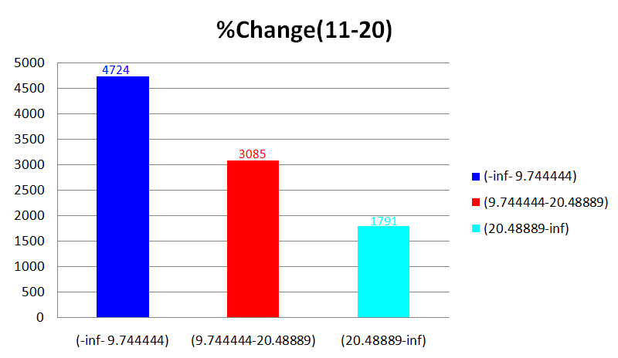
SMOTE Technique

Slide 11
False predictors
We have used two methods to determine false predictors in our data set:
1) Domain analysis: Our domain analysis brought out three false predictors in our cleaned data set:
1st Day
10th Day
2) Attribute accuracy
using OneR:
Page URL
Attribute | Accuracy
With Page URL | 99.37%
Without Page URL | 73.31%

Slide 12
Classifier selection
OneR
01
Naive Bayes
02
J48
03
JRip
04

Slide 13
Experiment Design: Four cell experiment design
Two Factor Design:
Our experiment design contained of two factors:
1. Factor 1 (F1) : Noise
2. Factor 2 (F2) : Percentage Split

Slide 14
Experiment Design: Four cell experiment design
Four Criteria of the Design: The two factors are to be divided up into 4 criteria by keeping one factor constant and varying the other factor between two values and vice versa.
Factors | No noise | With noise (10%)
Percentage Split (20%/80%) | C1 | C3
Percentage Split (80%/20%) | C2 | C4

Slide 15
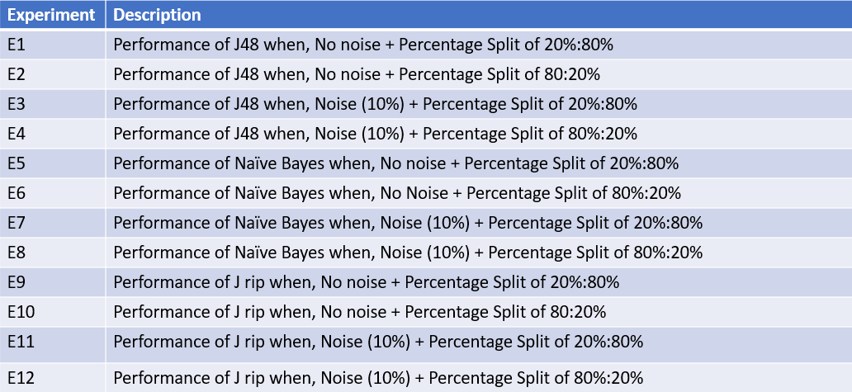
Description of Experiments conducted

Slide 16
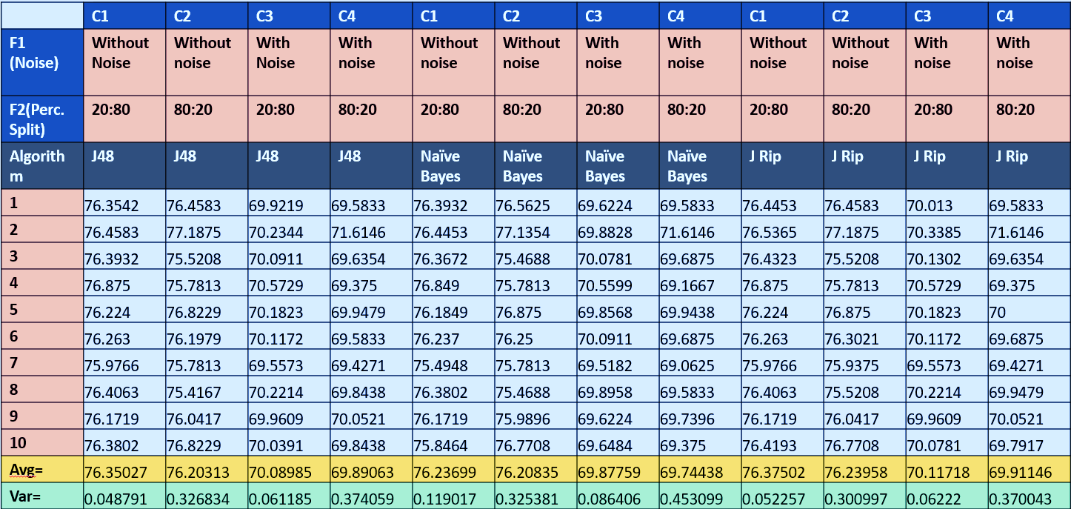
Experiments Results

Slide 17

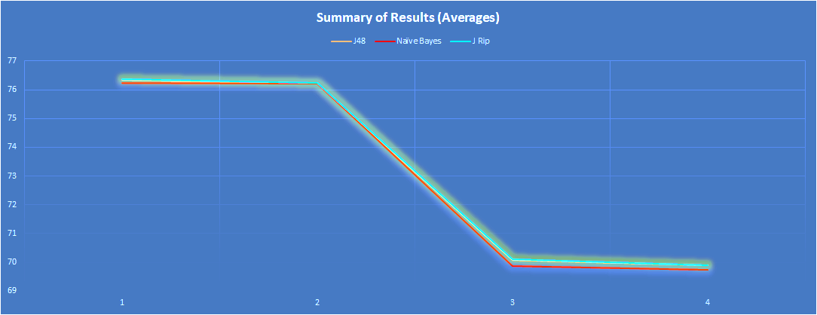
Summary of Results: Averages

Slide 18
Summary of Results: Averages
Summary of Averages | C1 | C2 | C3 | C4
J48 | 76.35027% | 76.20313% | 70.08985% | 69.89063%
Naïve Bayes | 76.23699% | 76.20835% | 69.87759% | 69.74438%
JRip | 76.37502% | 76.23958% | 70.11718% | 69.91146%
Here, as expected, C3 and C4 perform relatively poorly.
This is due to the introduction of noise in the data (class variable).
JRip provides the best performance among all the classifiers used to train data with an accuracy of 76.37502%
J48 comes second with a similar but slightly lower accuracy.
Our third classifier Naïve Bayes performs poorly compared to other algorithms.

Slide 19
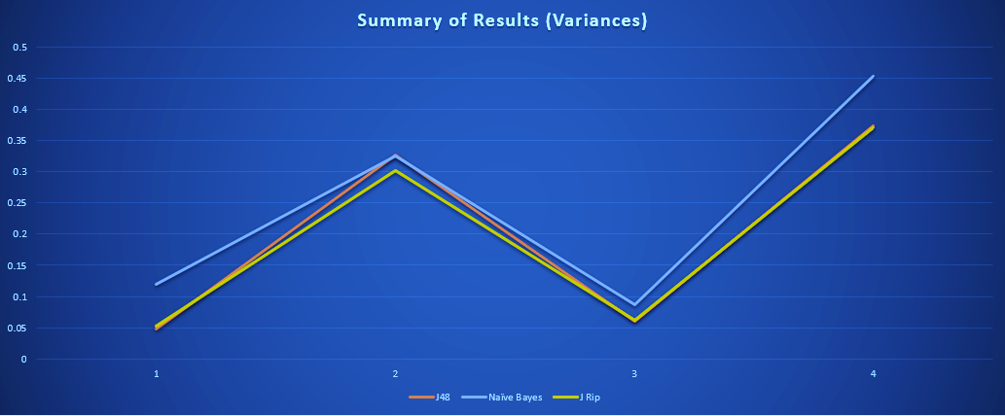
Summary of Results: Variance

Slide 20
Summary of Results: Variance
Summary of Variances | C1 | C2 | C3 | C4
J48 | 0.048791 | 0.326834 | 0.061185 | 0.374059
Naïve Bayes | 0.119017 | 0.325381 | 0.086406 | 0.453099
JRip | 0.052257 | 0.300997 | 0.06222 | 0.370043
As shown in the graph above, J48 has the lowest variance in a no noise – 20:80 percent split environment.
The Naïve Bayes has the highest variance among all three algorithms in the presence of noise.
The Naïve Bayes has the highest variation among all classifiers from C1 to C4 ; That is, the Naïve Bayes is the least stable among all three classifiers.
The Naïve Bayes classifier varied 5 times between C3 and C4 i.e.: in the presence of noise.

Slide 21
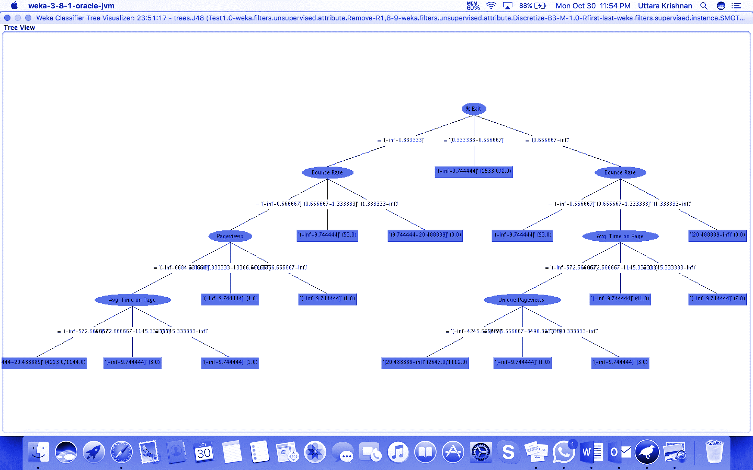
Weka Results
1) J48 :Decision Tree

Slide 22
Result
2) JRip
Rule Set Obtained:
Rule1:
(% Exit = '(0.666667-inf)') and (Bounce Rate = '(0.666667-1.333333]') and (Avg. Time on Page = '(-inf-572.666667]') and (Unique Pageviews = '(-inf-4245.666667]') and (%Change(1-10) = '(-inf-51.6]') => %Change(11-20)='(20.488889-inf)' (2645.0/1110.0)
Rule2:
(% Exit = '(-inf-0.333333]') and (Bounce Rate = '(-inf-0.666667]') and (Pageviews = '(-inf-6684.333333]') and (Avg. Time on Page = '(-inf-572.666667]') and (%Change(1-10) = '(-inf-51.6]') => %Change(11-20)='(9.744444-20.488889]' (4211.0/1142.0)
Rule3:
=> %Change(11-20)='(-inf-9.744444]' (2744.0/2.0)

Slide 23
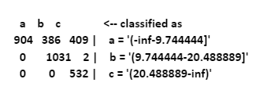
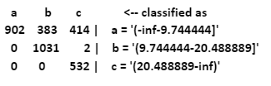
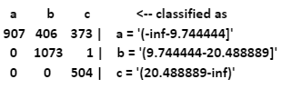
Result
Confusion Matrix
J48
Naïve Bayes
JRip

Slide 24
Conclusion
-Based on J48 Decision Tree results it was found that %Exit and Bounce Rate are contributing more in the prediction process of class attribute. This was a flaw in the business model. After an in depth analysis, suggestion was given to the company to change their business model.
- Based on suggestion, company’s Business model was changed. Web page content was changed and Bounce rate was reduced.

Slide 25
References
https://www.youtube.com/watch?v=P--UFzlNGeA- Weka Tutorial 06: Discretization (Data Preprocessing)
https://en.wikipedia.org/wiki/Weka_(machine_learning)
http://www.cs.put.poznan.pl/jstefanowski/sed/DM-6rulesnew.pdf
http://web.ydu.edu.tw/~alan9956/docu/refer/roc_introduction.pdf
https://analytics.google.com/analytics/web/?authuser=1#report/content-pages

